Slide 1


Deep Learning approach to Tomato Plant Diseases Recognition and related Sensitivity Analysis
Deep Learning approach to Tomato Plant Diseases Recognition and related Sensitivity Analysis
Milano, Luglio 2018
Deep Learning: Theory, Techniques and Applications
A.Y. 2017/2018
Alessandro Erba, Mirco Manzoni, Giuseppe Mascellaro

Slide 2
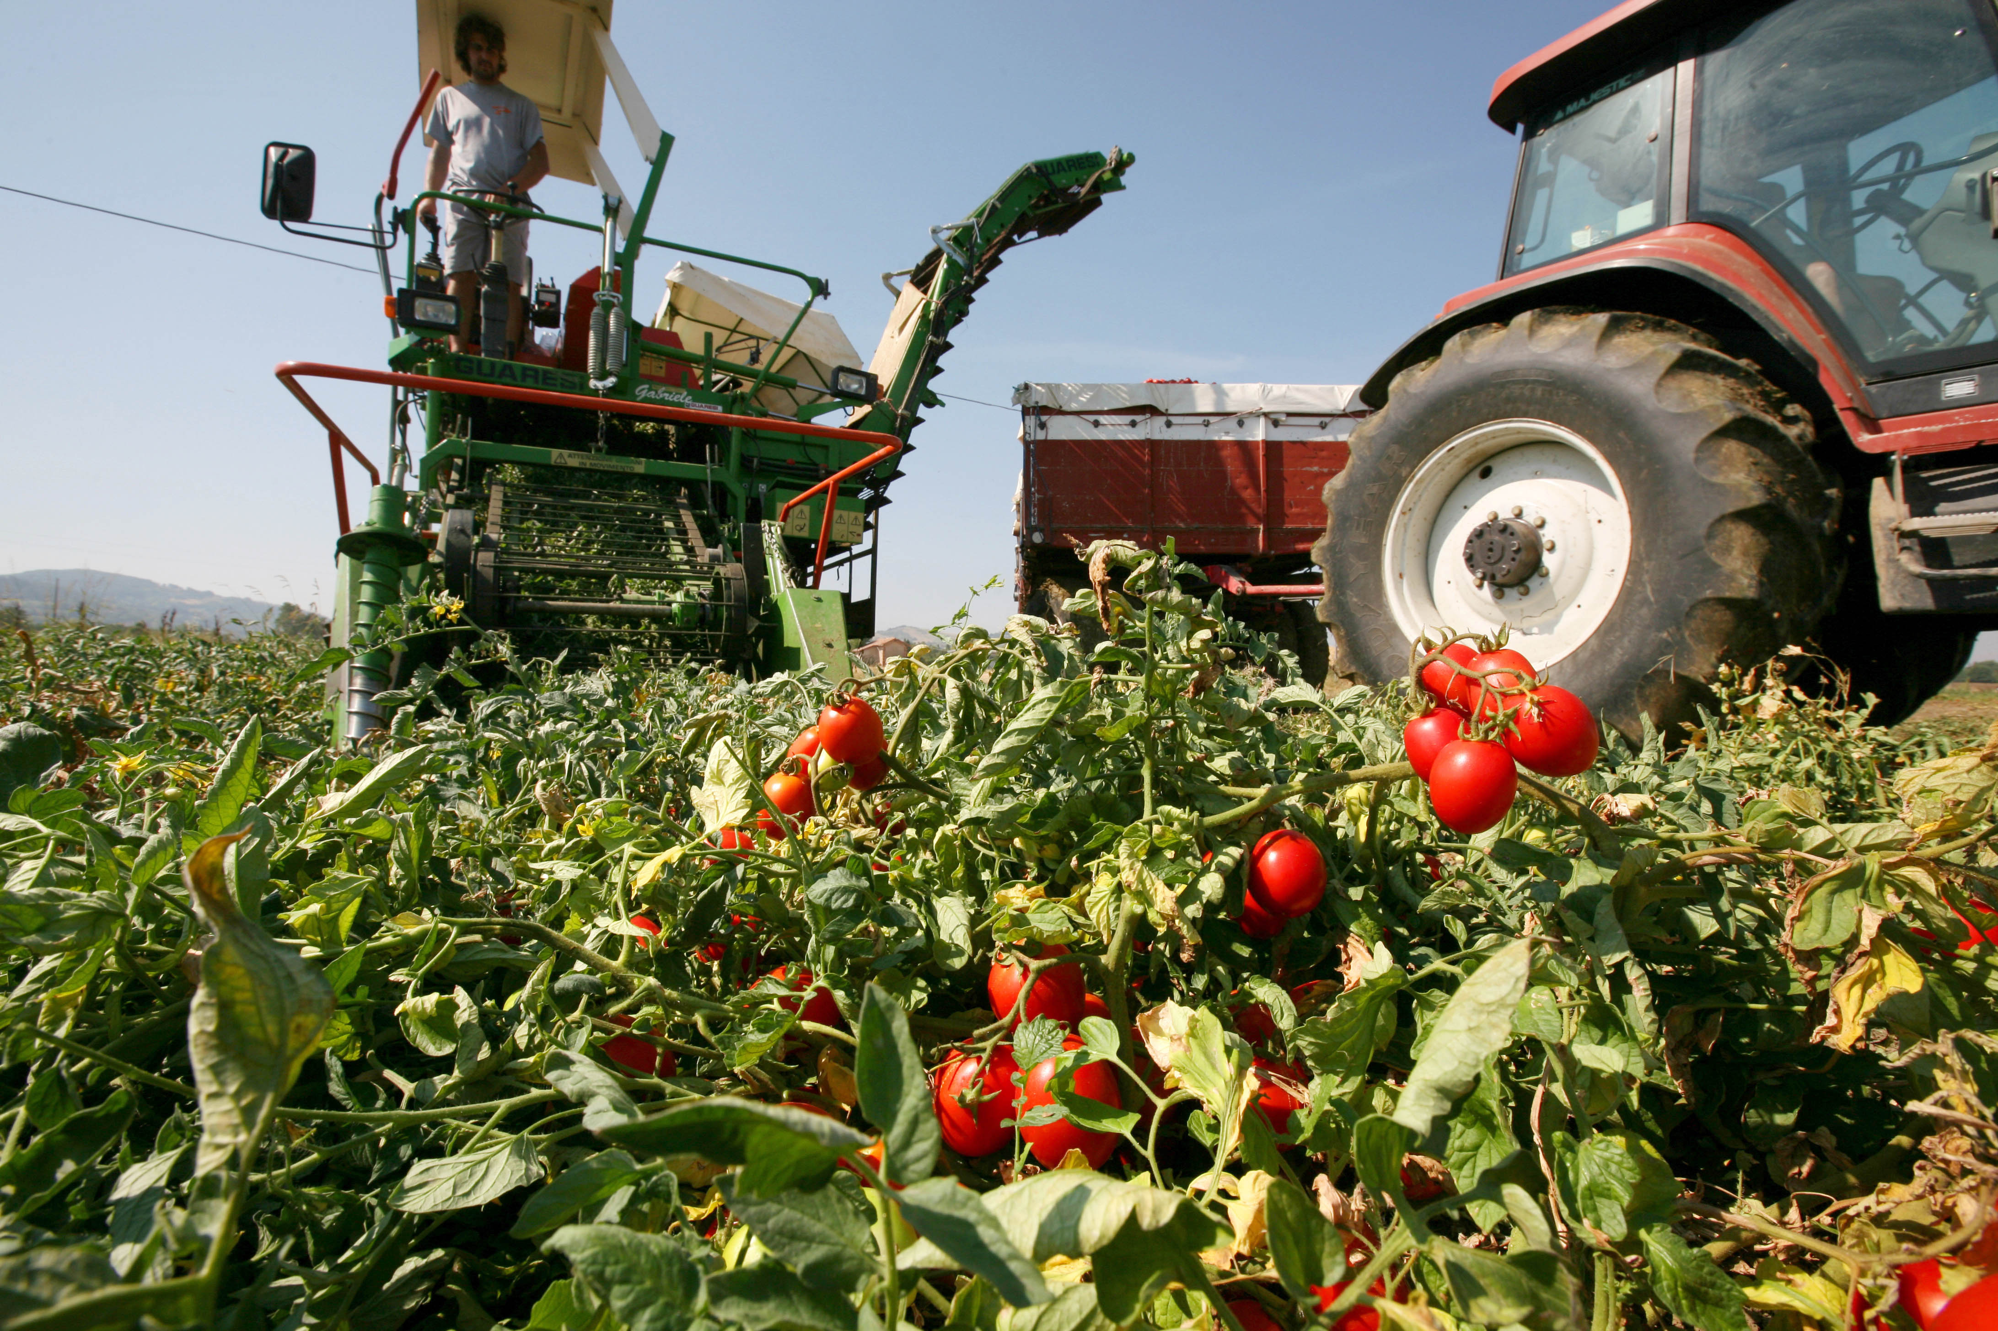
Deep Learning approach to Tomato Plant Diseases Recognition and related Sensitivity Analysis

Slide 3
Proposed Approach Workflow
Transformations Selection
Best Model
Transformations
Performances
Results
Model Validation
Model Selection
Sensitivity Analysis and Performance evaluation
Validation
Data
Train-Test Split
Train
Augmentation and Normalization
Model
Model Training
Test
Normalization Values
Train
Tests
Variations Application and Normalization
Hyper-parameters
Hyper-parameters Choice

Slide 4
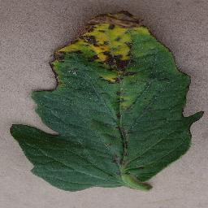
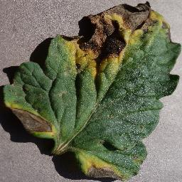
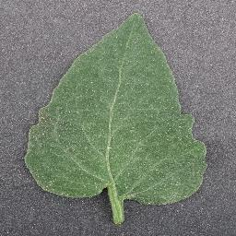
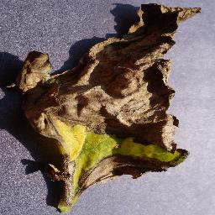
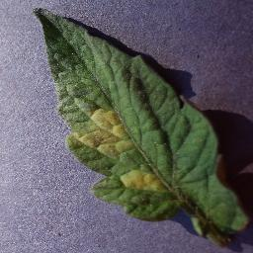
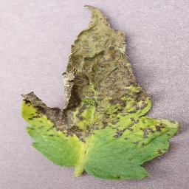
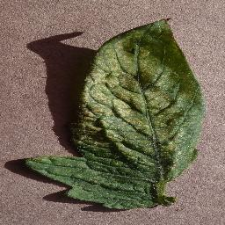
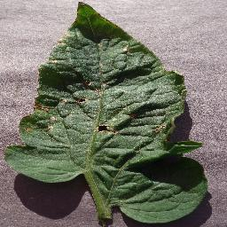
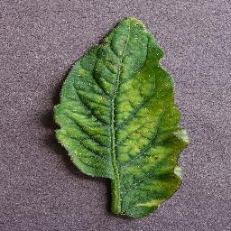
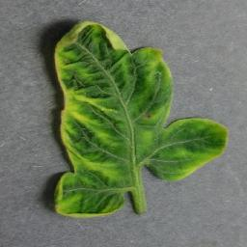
Dataset 18,158 tomato leaf images
Bacterial Spot
2,127 samples
Early Blight
1,000 samples
Healthy
1,590 samples
Late Blight
1,909 samples
Leaf Mold
952 samples
Septoria leaf spot
1,771 samples
Two Spotted Spider mite
1,676 samples
Target Spot
1,404 samples
Tomato Mosaic Virus
373 samples
Tomato Yellow Leaf Curl virus
5,356 samples

Slide 5
Data Augmentation and Normalization
Before the Training and Validation phases data are Augmented and Normalized.
Each sample is transformed taking two transformations from this pool:
Flip Top Bottom
Flip Left Right
Rotate 90°
Rotate 180°
Rotate 270°
Flip Top Bottom and Rotate 90°
Flip Top Bottom and Rotate 270°
Data are normalized in two different ways:
Dataset Normalization
Per-leaf Normalization

Slide 6
Binary Classification Setup
Healthy vs Infected
Architecture: LeNet
Initialization: Xavier
Activation Function: Rectified Linear Unit (ReLU)
Loss: binary cross-entropy
Optimizer: Adam
10-Fold cross-validation

Slide 7
Binary Classification Results
Hyper-parameters: batch size 32, epochs 15
Accuracy 99.92%
Precision 99.34%
Recall 99.67%
F1 - measure 99.5%
Confusion Matrix
True Healthy= 300 | False Infected = 1
False Healthy = 2 | True Infected = 3375

Slide 8
Multi-class Classification Setup
Architecture: AlexNet
Train from scratch
Transfer Learning
Initialization: Xavier
Activation Function: Rectified Linear Unit (ReLU)
Loss: cross-entropy
Optimizer: Adam
Cross-validation

Slide 9
Multi-class Classification Validation accuracy with different configurations

Slide 10
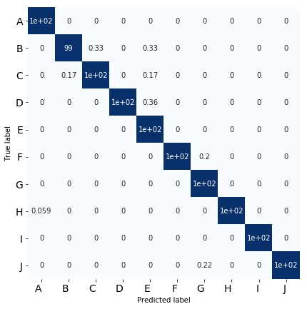
Multi-class Classification Results
Accuracy: 99.85%
Macro precision: 99.83%
Macro recall (True Rate): 99.82%
False Rate: 0.18%
Macro F1: 99.83%
Bacterial Spot
Early Blight
Late Blight
Leaf Mold
Septoria Leaf Spot
Two-spotted Spider Mites
Target Spot
Tomato Yellow Leaf Curl Virus
Tomato Mosaic Virus
Healthy

Slide 11
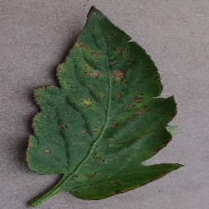
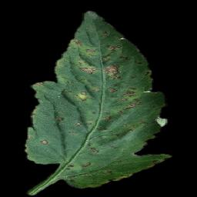
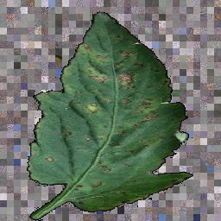
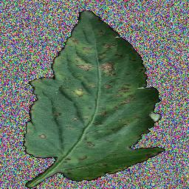
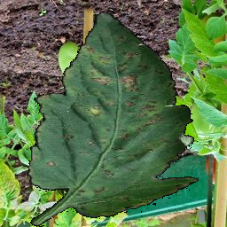
Sensitivity Analysis Datasets
Original dataset
Segmented dataset
Random Background
Crop dataset
Random Noise Background dataset
Random Background Image dataset

Slide 12
Sensitivity Analysis Normal Train vs Segmented Test
Train
Test
Original dataset
Segmented dataset
Accuracy: 39.01%
Macro precision: NaN
Macro recall (True Rate): 28.58%
False Rate: 71.41%
Macro F1: NaN

Slide 13
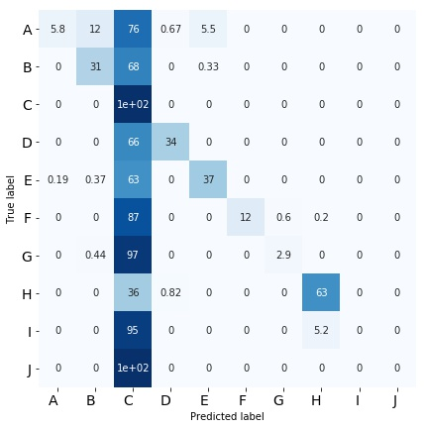
Sensitivity Analysis Normal Train vs Segmented Test
Bacterial Spot
Early Blight
Late Blight
Leaf Mold
Septoria Leaf Spot
Two-spotted Spider Mites
Target Spot
Tomato Yellow Leaf Curl Virus
Tomato Mosaic Virus
Healthy

Slide 14
Sensitivity Analysis Normal Train vs Normal Test – GradCAM Visualization
Bacterial Spot Class
Late Blight Class

Slide 15
Sensitivity Analysis Segmented Train vs Normal Test
Train
Test
Segmented dataset
Original dataset
Accuracy: 61.79%
Macro precision: 73.02%
Macro recall (True Rate): 49.41%
False Rate: 50.59%
Macro F1: 48.69%

Slide 16
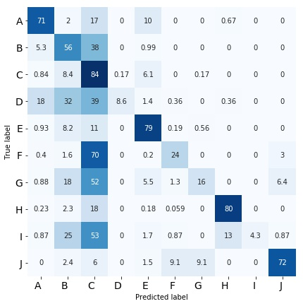
Sensitivity Analysis Segmented Train vs Normal Test
Bacterial Spot
Early Blight
Late Blight
Leaf Mold
Septoria Leaf Spot
Two-spotted Spider Mites
Target Spot
Tomato Yellow Leaf Curl Virus
Tomato Mosaic Virus
Healthy

Slide 17
Sensitivity Analysis Random Background Crop Train vs Normal Test
Train
Test
Random Background
Crop dataset
Original dataset
Accuracy: 76.92%
Macro precision: 76.92%
Macro recall (True Rate): 79.43%
False Rate: 32.70%
Macro F1: 67.15%

Slide 18
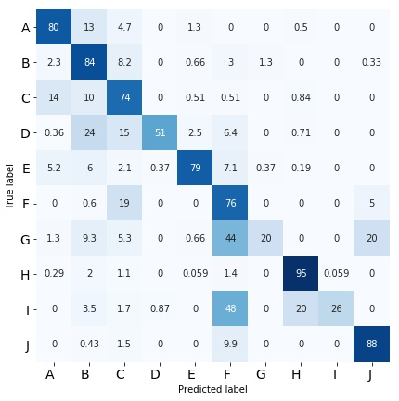
Sensitivity Analysis Random Background Crop Train vs Normal Test
Bacterial Spot
Early Blight
Late Blight
Leaf Mold
Septoria Leaf Spot
Two-spotted Spider Mites
Target Spot
Tomato Yellow Leaf Curl Virus
Tomato Mosaic Virus
Healthy

Slide 19
Sensitivity Analysis Random Noise Background Train vs Normal Test
Train
Test
Random Noise Background dataset
Original dataset
Accuracy: 57.89 %
Macro precision: 66.68%
Macro recall (True Rate): 49.01%
False Rate: 50.99%
Macro F1: 49.93%

Slide 20
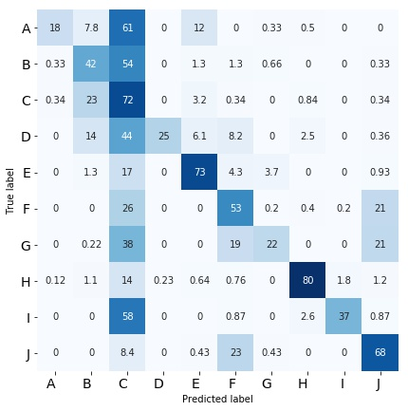
Sensitivity Analysis Random Noise Background Train vs Normal Test
Bacterial Spot
Early Blight
Late Blight
Leaf Mold
Septoria Leaf Spot
Two-spotted Spider Mites
Target Spot
Tomato Yellow Leaf Curl Virus
Tomato Mosaic Virus
Healthy

Slide 21
Sensitivity Analysis Random Background Image Train vs Normal Test
Train
Test
Per-leaf Normalization
Random Background Image dataset
Original dataset
Accuracy: 97.77%
Macro precision: 97.52%
Macro recall (True Rate): 96.69%
False Rate: 3.31%
Macro F1: 97.04%

Slide 22
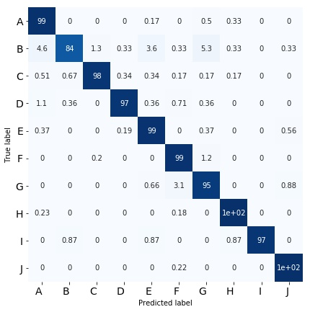
Sensitivity Analysis Random Background Image Train vs Normal Test
Bacterial Spot
Early Blight
Late Blight
Leaf Mold
Septoria Leaf Spot
Two-spotted Spider Mites
Target Spot
Tomato Yellow Leaf Curl Virus
Tomato Mosaic Virus
Healthy

Slide 23
Sensitivity Analysis Random Background Image Train vs Normal Test – GradCAM Visualization
Bacterial Spot Class
Late Blight Class

Slide 24
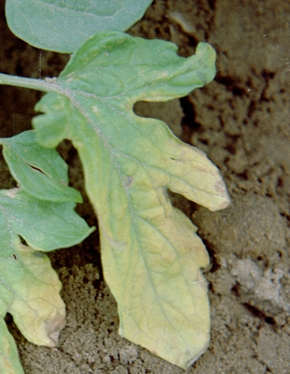
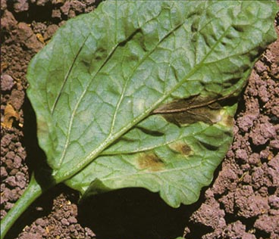
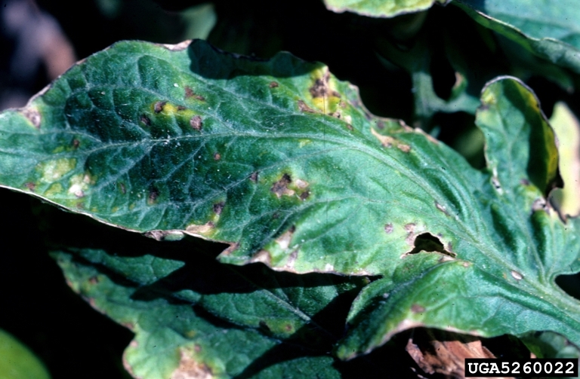
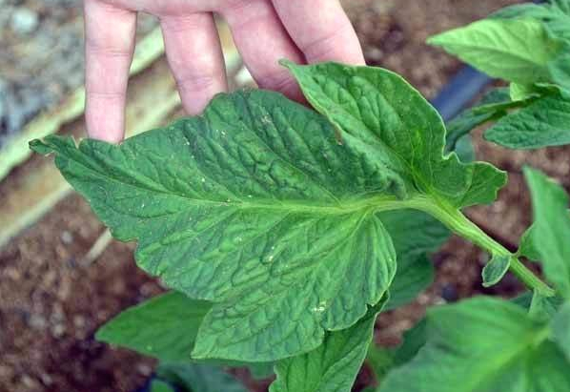
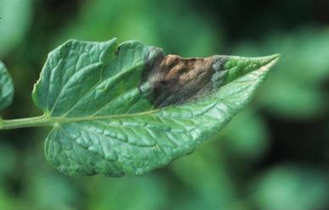
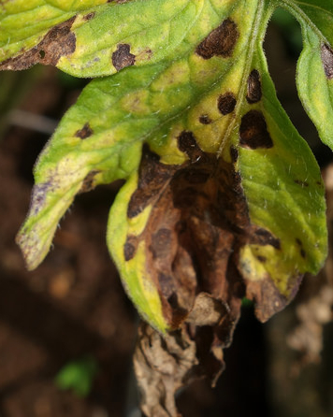
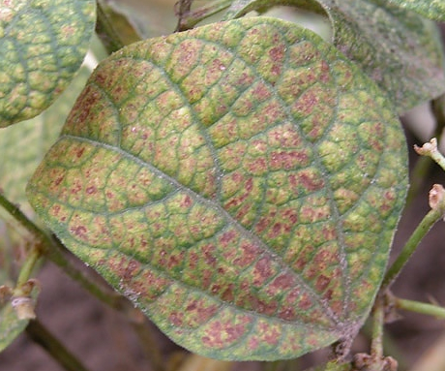
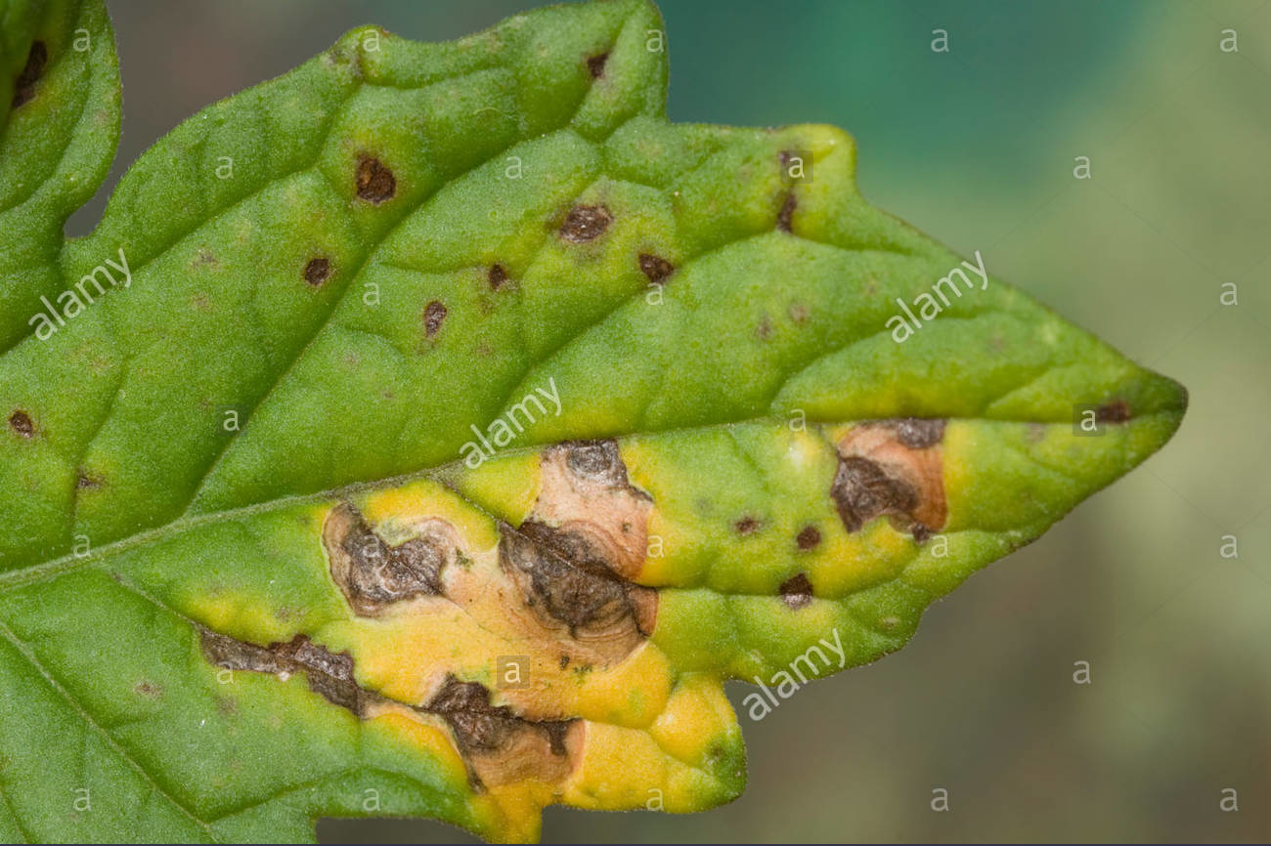
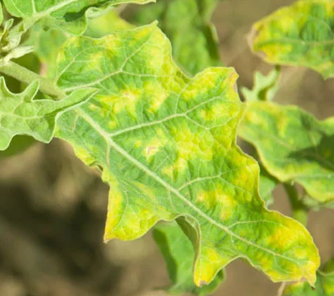
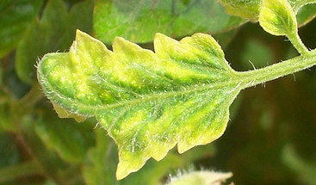
Extension Test against Real Plantation Images
We built a set of 256 found on Internet.
Bacterial Spot
26 samples
Early Blight
41 samples
Healthy
27 samples
Late Blight
31 samples
Leaf Mold
33 samples
Two Spotted Spider mite
12 samples
Target Spot
12 samples
Tomato Mosaic Virus
18 samples
Tomato Yellow Leaf Curl virus
29 samples
Septoria leaf spot
36 samples

Slide 25
Test against Real Plantation Images Results
AlexNet
Accuracy: 29.81%
VGG11
Accuracy: 35.85%
Main limitation:
the Internet dataset is not validated by a domain expert.

Slide 26
THANK YOU FOR YOUR ATTENTION

